Slide 1
Review of learning 5

Slide 2

Multiple choice (3)
Ava baked cupcakes for a party. She had completed
2-fifths of her baking when she stopped for lunch. After lunch, she baked 36 more cupcakes to finish the job. How many did she bake in total?
A | B | C | D
60 | 40 | 72 | 48
Notes:
This question connects to the content in the developing number sense activity (Activity 5)
Syllabus focus area:
Representing quantity fractions B

Slide 3

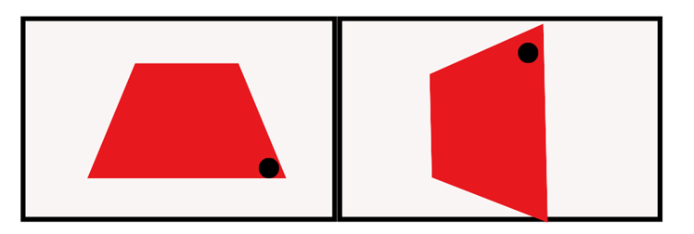
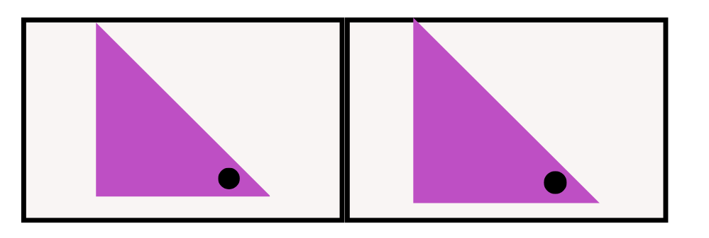
Short response (17)
Which terms can be used to describe the transformation of these shape?
The trapezium has been……
The triangle has been……
Notes:
Short response questions provide brisk paced questions focussing on review of current and previous content to support spaced and interleaved practice.
Syllabus focus area:
Two-dimensional spatial structure B: 2D shapes

Slide 4
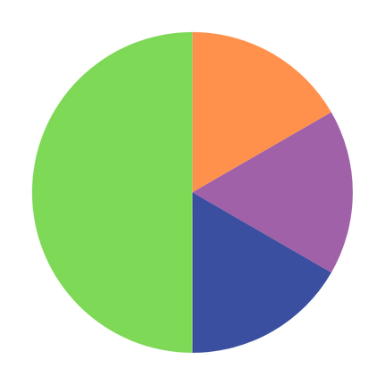
Short response (18)
When Sam spun this spinner 12 times, it landed on green 4 times. Explain why the number of times it landed on green might be different to what he expected.
Notes:
Short response questions provide brisk paced questions focussing on review of current and previous content to support spaced and interleaved practice.
Syllabus focus area:
Chance B

Slide 5
Short response (19)
Explain the relationship between the areas of a parallelogram, rectangle and triangle.
Notes:
Short response questions provide brisk paced questions focussing on review of current and previous content to support spaced and interleaved practice.
Syllabus focus area:
Two-dimensional spatial structure B: Area

Slide 6
Short response (20)
A rectangular prism with a volume of 36 cm³ has been constructed from centimetre cubes. The base layer contains 9 cubes. How many layers does it have?
Communicate your reasoning.
Notes:
Short response questions provide brisk paced questions focussing on review of current and previous content to support spaced and interleaved practice.
Syllabus focus area:
Three-dimensional spatial structure B: Volume

Slide 7



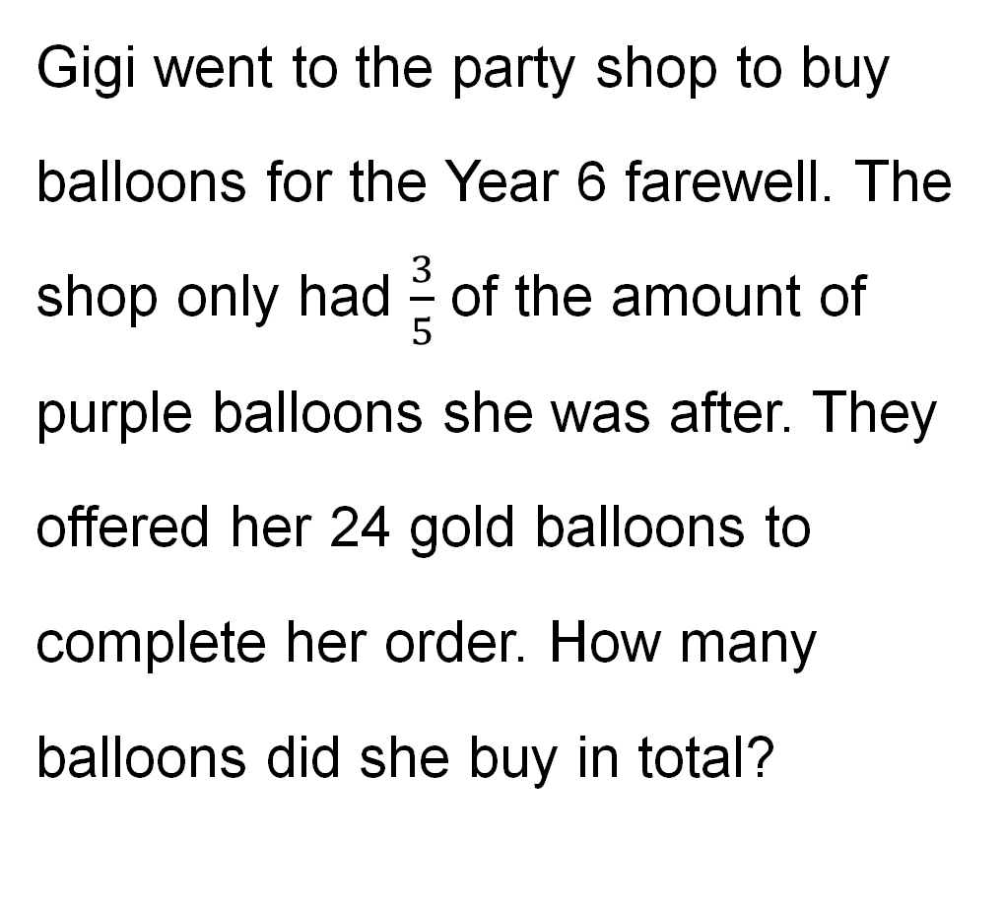
Activity 5 – fraction word problem (1)
Gigi went to the party shop to buy balloons for the Year 6 farewell. The shop only had $\frac{3}{5}$ of the amount of purple balloons she was after. They offered her 24 gold balloons to complete her order. How many balloons did she buy in total?
Notes:
This is a developing number sense activity.
Number sense refers to a deep understanding of numbers, including their magnitude, relationships, and the effects of operations on them. It supports fluency and understanding, estimation, flexible thinking, and efficient problem-solving. Number sense activities 1–4 ‘activate’ prior number knowledge and support the learning of new content in the unit. Number sense activities 5–8 ‘loop’ back and provide opportunity for spaced practice with concepts and procedures covered in previous units.
Syllabus focus area:
Representing quantity fractions B
This resource corresponds to Resource 24 - decoration fractions in Stage 3 Year B Unit 39.
Ask:
How did you split the problem into parts to solve it?
What fraction of the balloons is 24?
What is $\frac{1}{5}$ of the total amount?
How many purple balloons did Gigi buy?
What was the total amount of balloons?
What strategy did you use to solve the problem?
Were there strategies that other pairs used that you didn’t think of?
Which strategy was the most effective in solving this problem?
Consider the use of a bar model to demonstrate the problem solving and strategies applied by students

Slide 8
Review of learning 6

Slide 9

True or false (3)
$\frac{3}{4}$ of 32 = $\frac{2}{4}$ of 48
True | False
Communicate your reasoning.
Notes:
The question on this slide connects to the content being explored in the developing number sense activity (Activity 6)
Syllabus focus area:
Representing quantity fractions B

Slide 10
Short response (21)
One angle on this straight line is 125°.
What is the other angle?
Notes:
Short response questions provide brisk paced questions focussing on review of current and previous content to support spaced and interleaved practice.
Syllabus focus area:
Geometric measure B: Angles

Slide 11
Short response (22)
What does the term ‘bias’ mean
Identify 3 sources of possible bias in data found in the media.
Notes:
Short response questions provide brisk paced questions focussing on review of current and previous content to support spaced and interleaved practice.
Syllabus focus area:
Data A

Slide 12
Short response (23)
Find the volume of this prism.
4 m
6 m
6 m
Communicate your method.
Notes:
Short response questions provide brisk paced questions focussing on review of current and previous content to support spaced and interleaved practice.
Syllabus focus area:
Three-dimensional spatial structure B: Volume

Slide 13
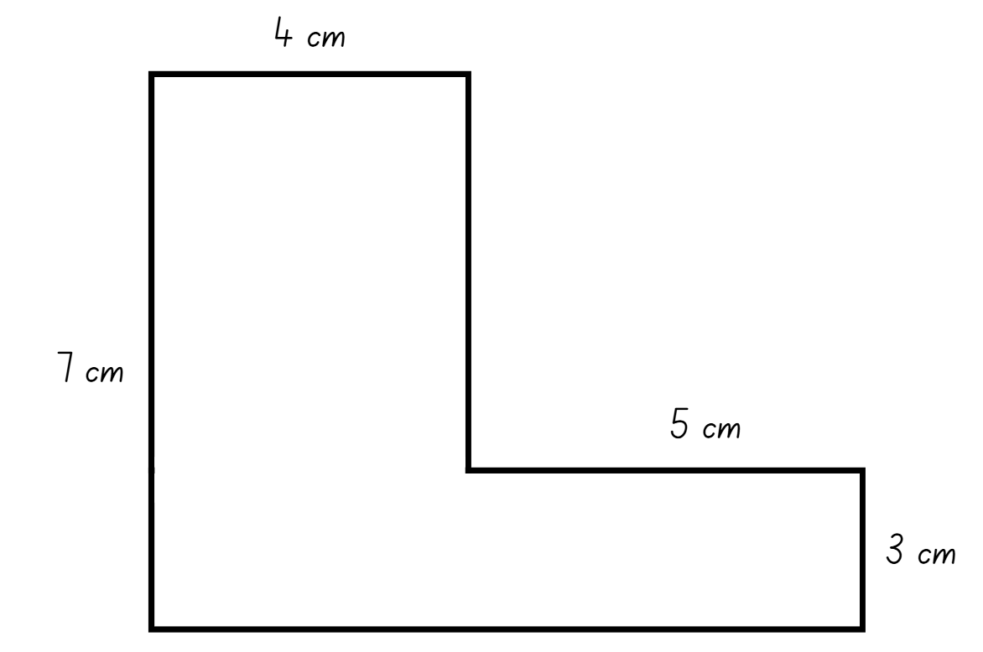
Short response (24)
Show 2 different ways to find the area of this composite shape.
Notes:
Short response questions provide brisk paced questions focussing on review of current and previous content to support spaced and interleaved practice.
Syllabus focus area:
Two-dimensional spatial structure B: Area

Slide 14
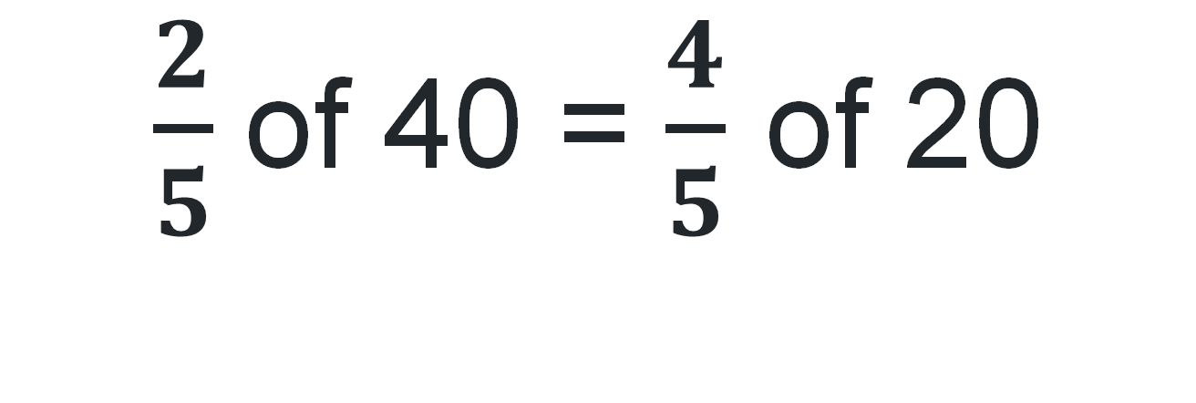
Activity 6 – fraction inquiry (1)
$\frac{2}{5}$of 40 = $\frac{4}{5}$ of 20
Notes:
This is a developing number sense activity.
Number sense refers to a deep understanding of numbers, including their magnitude, relationships, and the effects of operations on them. It supports fluency and understanding, estimation, flexible thinking, and efficient problem-solving. Number sense activities 1–4 ‘activate’ prior number knowledge and support the learning of new content in the unit. Number sense activities 5–8 ‘loop’ back and provide opportunity for spaced practice with concepts and procedures covered in previous units.
Syllabus focus area:
Representing quantity fractions B
This resource corresponds to Resource 25 – blank tape diagram in Stage 3 Year B Unit 39.
This activity is an adaptation of Fraction of a number inquiry from Inquiry Maths by Hindle.
Slide 46-48 are used for this activity.
Ask:
Is the equation true or false? Explain your reasoning.
Was using the tape diagram helpful to figure out the fraction of the quantity? Why or why not?
What is another way you could have solved this problem?
Do you see any connections to other mathematical concepts?

Slide 15
Activity 6 – fraction inquiry (2)
Notes:
Note: This slide is designed to be used in presentation mode.
Provide students with individual whiteboards. Explain that they need to determine whether the equation is true or false and justify their answer using a tape diagram.
Students turn and talk, sharing their diagrams and reasoning.
Regroup and ask the following questions:
Is the equation true or false? Explain your reasoning.
Was using the tape diagram helpful to figure out the fraction of the quantity? Why or why not?
What is another way you could have solved this problem?
Do you see any connections to other mathematical concepts?
This resource corresponds to Resource 25 – blank tape diagram in Stage 3 Year B Unit 39.

Slide 16
Activity 6 – fraction inquiry (3)
40
8
8
8
8
8
0
8
16
24
32
40
20
4
4
4
4
4
0
4
8
12
16
20
Notes:
Note: This slide is designed to be used in presentation mode.
Animated tape diagram to model the problem solving and strategies applied by the students.
This resource corresponds to Resource 25 – blank tape diagram in Stage 3 Year B Unit 39.

Slide 17
Review of learning 7

Slide 18
Multiple choice (4)
A quarter of 36 is…
9
A
B
8.5
C
17
D
10.25
Notes:
This question connects to the content in the developing number sense activity (Activity 7)
Syllabus focus area:
Representing quantity fractions B

Slide 19
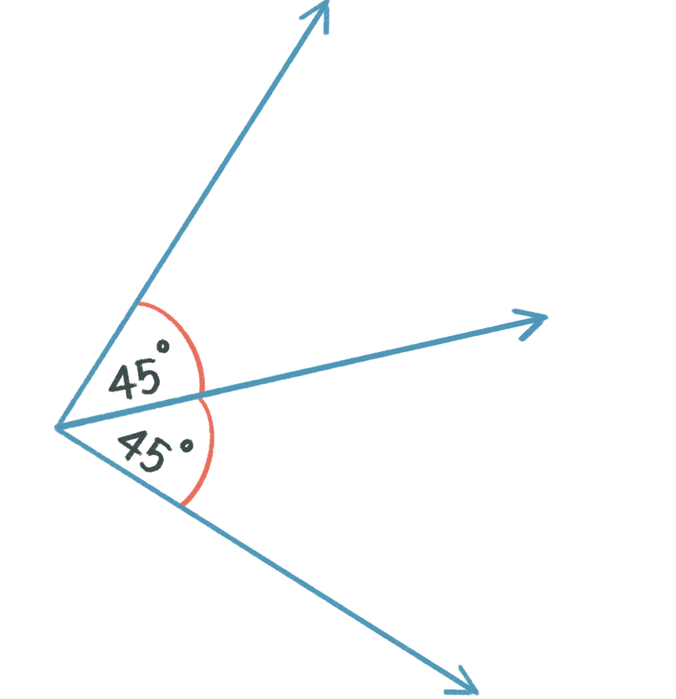
Short response (25)
Do these angles form a right angle?
How do you know?
Notes:
Short response questions provide brisk paced questions focussing on review of current and previous content to support spaced and interleaved practice.
Syllabus focus area:
Geometric measure A: Angles

Slide 20
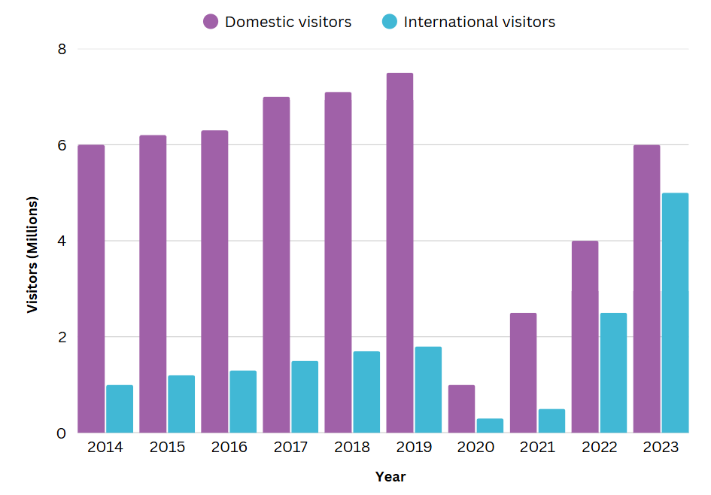
Short response (26)
Use the data to answer:
Which year had the highest total number of visitors? What was that total?
In which year did international visitors make up the largest proportion of total visitors?
What might you predict about visitor numbers in 2024?
Notes:
Short response questions provide brisk paced questions focussing on review of current and previous content to support spaced and interleaved practice.
Syllabus focus area:
Data B

Slide 21
Short response (27)
Two prisms have the same volume.
Prism A is 2 cm long, 3 cm wide and 10 cm high.
Prism B is 5 cm long and 2 cm wide.
Calculate the missing dimension of prism B?
Notes:
Short response questions provide brisk paced questions focussing on review of current and previous content to support spaced and interleaved practice.
Syllabus focus area:
Three-dimensional spatial structure B: Volume

Slide 22
Short response (28)
A bus leaves Sydney Central Station at 10:35 am and arrives in Newcastle at 14:20.
How long did the journey take?
Notes:
Short response questions provide brisk paced questions focussing on review of current and previous content to support spaced and interleaved practice.
Syllabus focus area:
Non-spatial measure: Time

Slide 23
Activity 7 – fraction bingo (1)
1
2
1
4
1
1
1
1
is half of a
is 2.5
of 10
of 10
4
2
4
4
1
of 10 is 5
1
of 5 is 2.5
We can say
2
2
Notes:
Note: This slide is designed to be used in presentation mode.
This is a developing number sense activity.
Number sense refers to a deep understanding of numbers, including their magnitude, relationships, and the effects of operations on them. It supports fluency and understanding, estimation, flexible thinking, and efficient problem-solving. Number sense activities 1–4 ‘activate’ prior number knowledge and support the learning of new content in the unit. Number sense activities 5–8 ‘loop’ back and provide opportunity for spaced practice with concepts and procedures covered in previous units.
Syllabus focus area:
Representing quantity fractions B
This resource corresponds to Resource 26 – fraction wall in Stage 3 Year B Unit 39.
Slide 55-58 are used for this activity.
Explain that $\frac{1}{4}$ is equal to a half of a half.
Model how to apply this concept to fractions of a collection. For example, to calculate $\frac{1}{4}$ of 10, we can calculate $\frac{1}{2}$ of 10 is 5 and then $\frac{1}{2}$ of 5 is 2$\frac{1}{2}$, which can be expressed as 2.5.

Slide 24
Activity 7 – fraction bingo (3)
1
1
1
2
2
1
1
1
1
4
4
4
4
1
1
1
1
1
1
1
1
1
1
10
10
10
10
10
10
10
10
10
10
0
0.1
0.25
0.5
0.75
1
Notes:
This resource corresponds to Resource 26 – fraction wall in Stage 3 Year B Unit 39.
Highlight equivalence between benchmark fractions and decimals.
Review that$\frac{1}{2}$ is expressed as 0.5 when written as a decimal. Repeat with $\frac{1}{4}$ as .25, $\frac{3}{4}$ as .75 and $\frac{1}{10}$ as .10.
Explain to students that they will be calculating $\frac{1}{2}$ and $\frac{1}{4}$ of numbers where all the answers will have a remainder.
Explain that $\frac{1}{4}$ is equal to a half of a half.

Slide 25
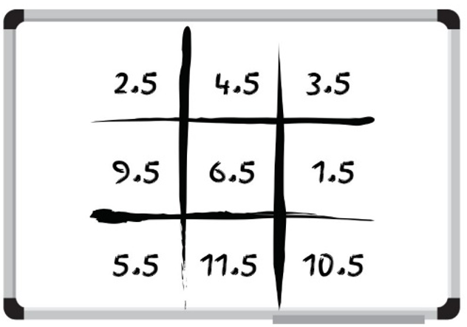


Activity 7 – fraction bingo (2)
Draw a 3 x 3 bingo board
Fill in numbers between 1 – 15.
Each number must include a decimal value of 0.5.
Listen to the bingo numbers called and mark off your numbers.
Notes:
Provide students with individual whiteboards and ask them to create a 3 × 3 bingo board.
Ask students to fill the bingo board with numbers between 1–15. Explain all answers will have a remainder of $\frac{1}{2}$, so each number they write must have a decimal value of .5 such as 3.5, 4.5

Slide 26
Review of learning 8

Slide 27
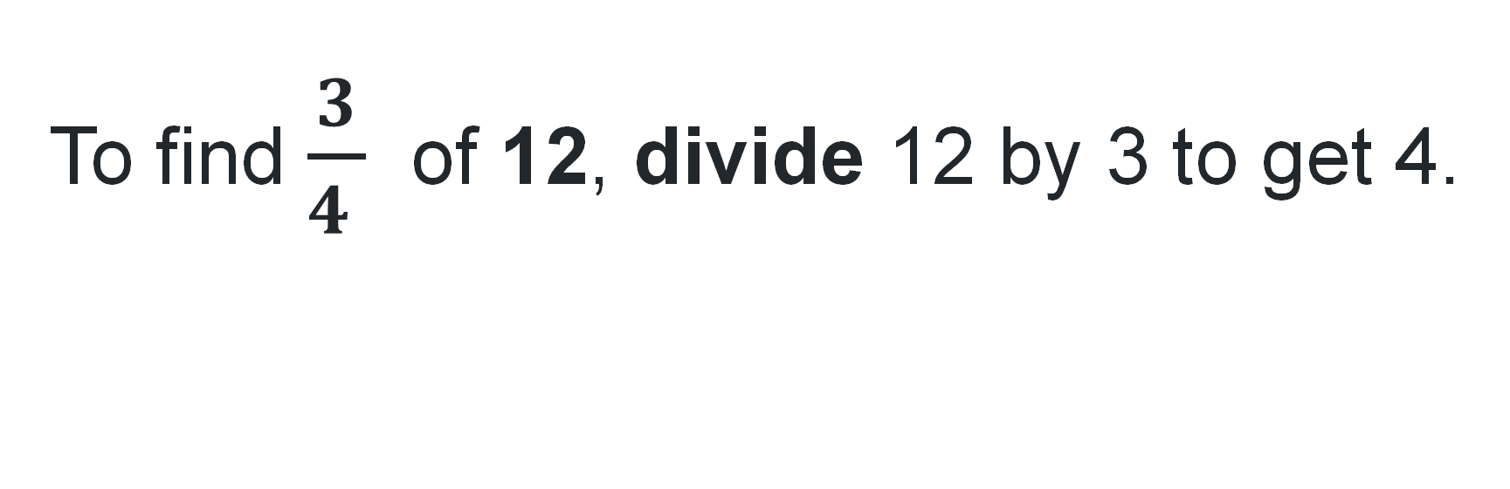
True or false (4)
To find $\frac{3}{4 }$ of 12, divide 12 by 3 to get 4.
True | False
Notes:
The question on this slide connects to the content being explored in the developing number sense activity (Activity 8)
Syllabus focus area:
Representing quantity fractions B

Slide 28
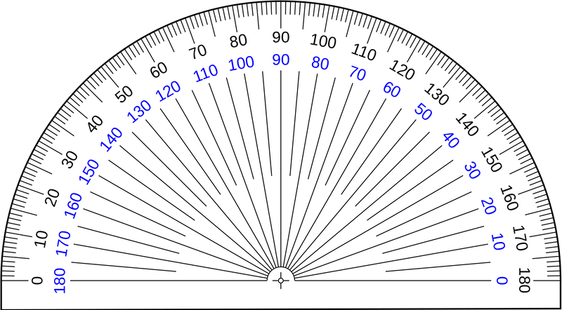
Short response (29)
Measure and describe these angles using the terms acute, obtuse or reflex.
Notes:
Short response questions provide brisk paced questions focussing on review of current and previous content to support spaced and interleaved practice.
Syllabus focus area:
Geometric measure A: Angles

Slide 29
Short response (30)
Describe one similarity and one difference between Grade 2 and Grade 3 in this side-by-side column graph.
Notes:
Short response questions provide brisk paced questions focussing on review of current and previous content to support spaced and interleaved practice.
Syllabus focus area:
Data B

Slide 30
Short response (31)
A prism is 20 cm long, 15 cm wide and 10 cm high.
Find its volume in cubic centimetres.
Notes:
Short response questions provide brisk paced questions focussing on review of current and previous content to support spaced and interleaved practice.
Syllabus focus area:
Three-dimensional spatial structure B: Volume

Slide 31
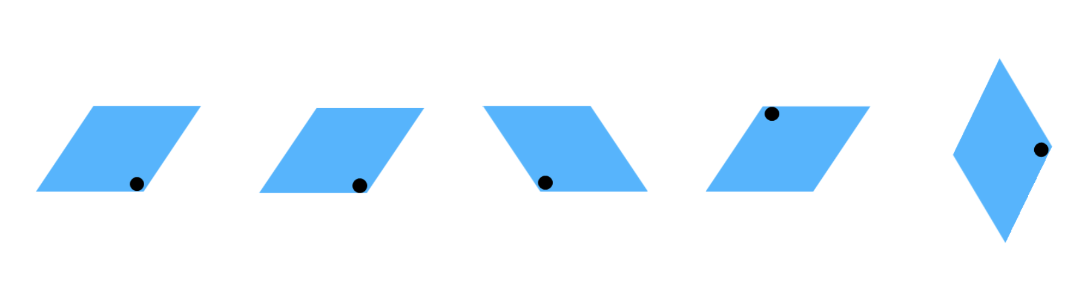
Short response (32)
Describe each of the transformations of the parallelogram.
Notes:
Short response questions provide brisk paced questions focussing on review of current and previous content to support spaced and interleaved practice.
Syllabus focus area:
Two-dimensional spatial structure: 2D shapes

Slide 32
Activity 8 – finding fractional quantities
To find $\frac{3}{5}$ of 15, Josh divided 15 by 3 to get 5, then multiplied by 5 to get 25.
To find $\frac{2}{5}$ of 25, Grace divided by 5 to get 5, and then multiplied by 2 to get 10.
To find $\frac{3}{4}$ of 24, Ben divided 24 by 4 to get 6.
To find $\frac{3}{5}$ of 20, Fatima divided 20 by 4 to get 5, then multiplied by 3 to get 15.
Notes:
Note: This slide is designed to be used in presentation mode.
This is a developing number sense activity.
Number sense refers to a deep understanding of numbers, including their magnitude, relationships, and the effects of operations on them. It supports fluency and understanding, estimation, flexible thinking, and efficient problem-solving. Number sense activities 1–4 ‘activate’ prior number knowledge and support the learning of new content in the unit. Number sense activities 5–8 ‘loop’ back and provide opportunity for spaced practice with concepts and procedures covered in previous units.
Syllabus focus area:
Representing quantity fractions B
Pose the following question to students: To find $\frac{3}{5}$ of 15, Josh divided 15 by 3 to get 5, then multiplied by 5 to get 25.
Students work with a partner to use a tape diagram to solve calculate the answer and discuss if Grace was correct, justifying their reasoning and any mistakes that may have been made.
Each group shares the mathematical thinking from their discussion.
Repeat with further examples:
To find $\frac{2}{5}$ of 25, Grace divided by 5 to get 5, and then multiplied by 2 to get 10.
To find $\frac{3}{4 }$ of 24, Ben divided 24 by 4 to get 6.
To find $\frac{3}{5}$ of 20, Fatima divided 20 by 4 to get 5, then multiplied by 3 to get 15.

Slide 33
Double Venn diagram
Object 1
Object 2
Features similar to both objects
Features of object 1
Features of object 2

Slide 34
Frayer
Definition
Facts/Characteristics
Word, term, concept
Examples
Non-examples

Slide 35
Spider map
Idea
Subject

Slide 36
Cline
Concept 1
Concept 2
Word
Word
Word
Word
Word
Word
Word
Word
Word
Word
Word

Slide 37
Compare and contrast
Notes:
Use the arrows to navigate between related activities.
Hyperlink each arrow to compare between related slides.

Slide 38
Multiple choice (5)
A
B
C
D
Notes:
This question connects to the content in the developing number sense activity (Activity 1)
This question can:
support spaced and interleaved practice
help identify and address common misconceptions
support active recall and immediate feedback
support whole class participation
identify areas requiring reteach
Teachers are encouraged to adapt and contextualise for their contexts.

Slide 39
Multiple choice (6)
A
B
C
D
Notes:
This question connects to the content in the developing number sense activity (Activity 1)
Syllabus focus area:
Multiplicative relations A
This question can:
support spaced and interleaved practice
help identify and address common misconceptions
support active recall and immediate feedback
support whole class participation
identify areas requiring reteach
Teachers are encouraged to adapt and contextualise for their contexts.

Slide 40
References
This presentation contains NSW Curriculum and syllabus content. The NSW Curriculum is developed by the NSW Education Standards Authority. This content is prepared by NESA for and on behalf of the Crown in the right of the State of New South Wales. The material is protected by Crown copyright.
Please refer to the NESA Copyright Disclaimer for more information https://educationstandards.nsw.edu.au/wps/portal/nesa/mini-footer/copyright.
NESA holds the only official and up-to-date versions of the NSW Curriculum and syllabus documents. Please visit the NSW Education Standards Authority (NESA) website https://educationstandards.nsw.edu.au/wps/portal/nesa/home and the NSW Curriculum website https://curriculum.nsw.edu.au.
Mathematics K–10 Syllabus © NSW Education Standards Authority (NESA) for and on behalf of the Crown in right of the State of New South Wales, 2022.
National Numeracy Learning Progression © Australian Curriculum, Assessment and Reporting Authority (ACARA) 2010 to present, unless otherwise indicated. This material was downloaded from the Australian Curriculum website (National Literacy Learning Progression) (accessed 8 April 2024 and was not modified.
Barton C (2019) Volume of a cuboid 1, Maths Venns Website, accessed 8 April 2024.
Finkel D (2019) Fill the Stairs, Math for Love website, accessed 8 April 2024.
NESA (NSW Education Standards Authority) (2024) ‘Teaching advice for Three-dimensional spatial structure A’, Stage 3, NESA website, accessed 30 May 2024.
State of New South Wales (Department of Education) (2023) ‘Factors fun’, Mathematics K–6 resources, NSW Department of Education website, accessed 3 April 2024.

Slide 41
References
This presentation contains NSW Curriculum and syllabus content. The NSW Curriculum is developed by the NSW Education Standards Authority. This content is prepared by NESA for and on behalf of the Crown in the right of the State of New South Wales. The material is protected by Crown copyright.
Please refer to the NESA Copyright Disclaimer for more information https://educationstandards.nsw.edu.au/wps/portal/nesa/mini-footer/copyright.
NESA holds the only official and up-to-date versions of the NSW Curriculum and syllabus documents. Please visit the NSW Education Standards Authority (NESA) website https://educationstandards.nsw.edu.au/wps/portal/nesa/home and the NSW Curriculum website https://curriculum.nsw.edu.au.
Sullivan P (2018) Challenging Mathematical Tasks, Oxford University Press Australia and New Zealand.
University of Cambridge (n.d.a) Area and Perimeter, NRICH website, accessed 4 April 2024.
——(n.d.b) Factor-multiple Chains, NRICH website, accessed 4 April 2024.
——(n.d.c) Rod Area, NRICH website, accessed 4 April 2024.
——(n.d.d) Route Product, NRICH website, accessed 4 April 2024.

Slide 42
Copyright
© State of New South Wales (Department of Education), 2025
The copyright material published in this resource is subject to the Copyright Act 1968 (Cth) and is owned by the NSW Department of Education or, where indicated, by a party other than the NSW Department of Education (third-party material).
Copyright material available in this resource and owned by the NSW Department of Education is licensed under a Creative Commons Attribution 4.0 International (CC BY 4.0) license.
This license allows you to share and adapt the material for any purpose, even commercially.
Attribution should be given to © State of New South Wales (Department of Education), 2025.
Material in this resource not available under a Creative Commons license:
the NSW Department of Education logo, other logos and trademark-protected material
Material owned by a third party that has been reproduced with permission. You will need to obtain permission from the third party to reuse its material.
Links to third-party material and websites
Please note that the provided (reading/viewing material/list/links/texts) are a suggestion only and implies no endorsement, by the New South Wales Department of Education, of any author, publisher, or book title. School principals and teachers are best placed to assess the suitability of resources that would complement the curriculum and reflect the needs and interests of their students.
If you use the links provided in this document to access a third party’s website, you acknowledge that the terms of use, including licence terms set out on the third-party’s website apply to the use which may be made of the materials on that third-party website or where permitted by the Copyright Act 1968 (Cth). The department accepts no responsibility for content on third-party websites.

